Slide 1
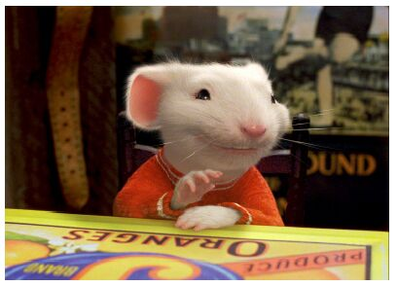
CSE- 4105
Lecture- 07
Transformation-II

Slide 2
Rotation
A rotation repositions all points in an object along a circular path in the plane centered at the pivot point.
First, we’ll assume the pivot is at the origin.
P’
θ
P

Slide 3

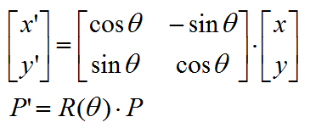
Rotation
Rotate through an angle θ about the origin
y
P’(x’, y’)
P(x, y)
θ
x

Slide 4




Rotation
Derivation of the rotation equation
y
P’(x’, y’)
rsin(φ+θ)
P(x, y)
rsinφ
r
θ
φ
x
rcos(φ+θ)
rcosφ

Slide 5

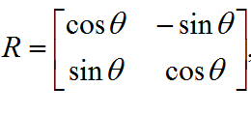
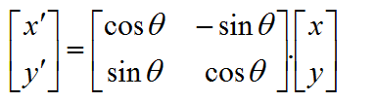

Rotation
Rewriting in matrix form gives us :

Slide 6
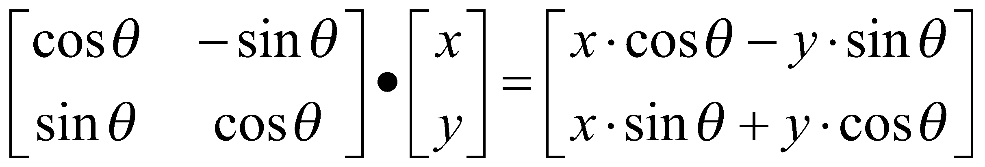
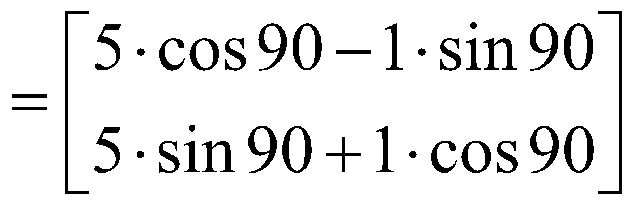
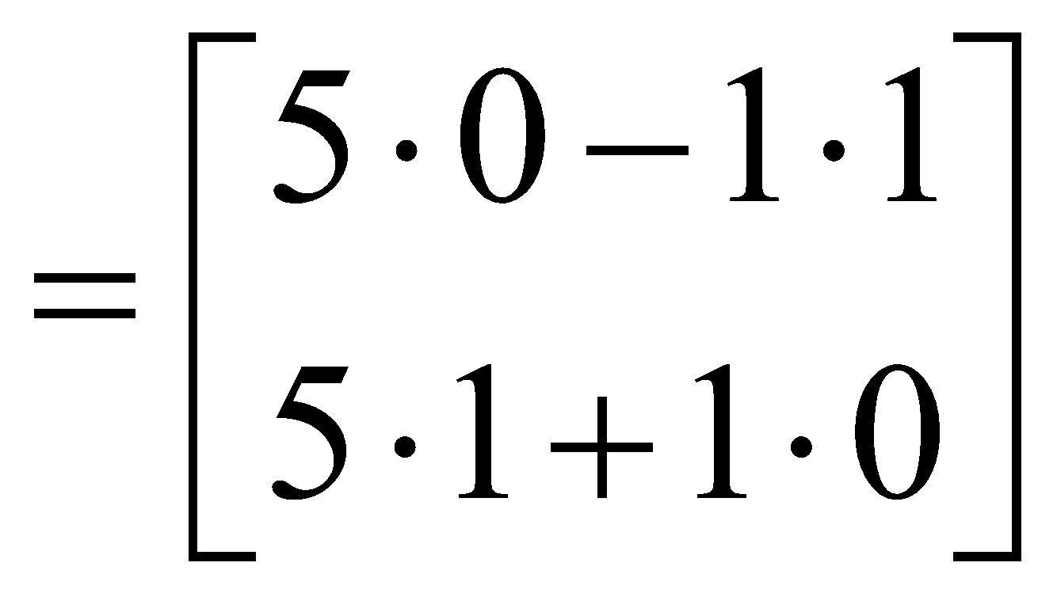
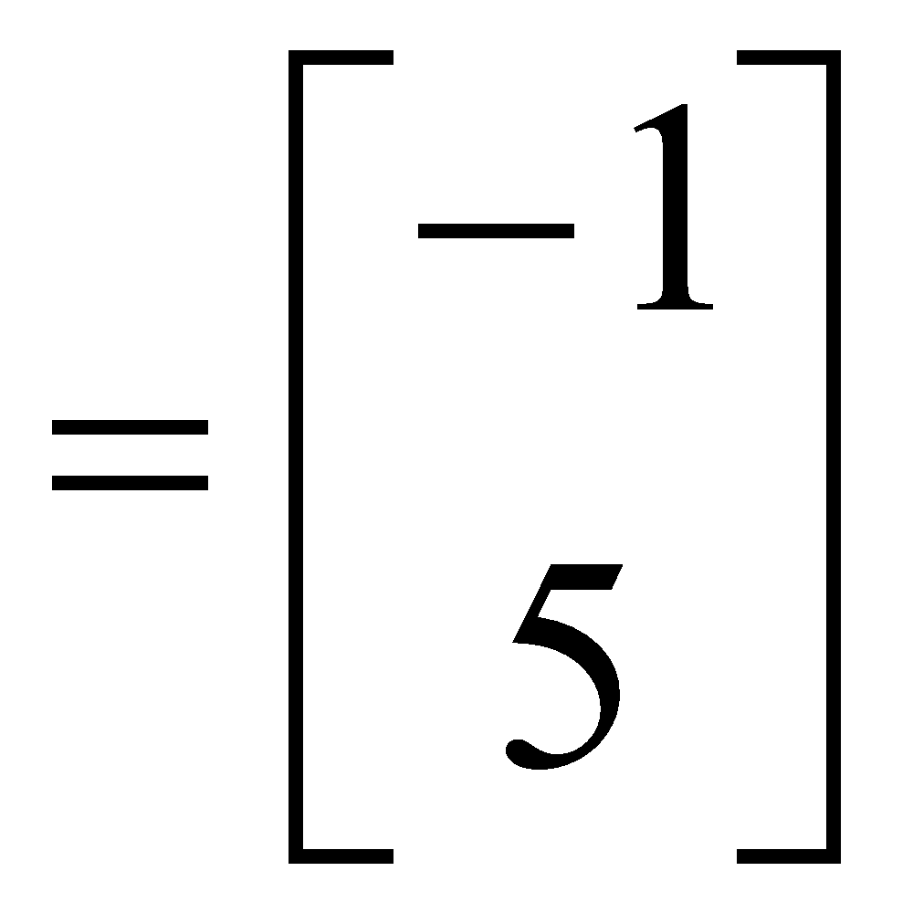
Rotation
Example
Find the transformed point, P’, caused by rotating P= (5, 1) about the origin through an angle of 90°.

Slide 7
Transformations.
Translation.
P′=T + P
Scale
P′=S ⋅ P
Rotation
P′=R ⋅ P
We would like all transformations to be multiplications

Slide 8

Homogeneous Coordinates
A point (x, y) can be re-written in homogeneous coordinates as (x_{h}, y_{h}, h)
The homogeneous parameter h is a non- zero value such that:
We can then write any point (x, y) as (hx, hy, h)
We can conveniently choose h = 1 so that (x, y) becomes (x, y, 1)

Slide 9
Homogenous Coordinates
Mathematicians commonly use homogeneous coordinates as they allow scaling factors to be removed from equations
We will see in a moment that all of the transformations we discussed previously can be represented as 3*3 matrices
Using homogeneous coordinates allows us use matrix multiplication to calculate transformations – extremely efficient!

Slide 10
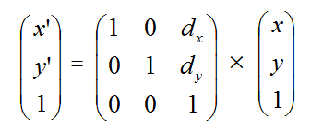

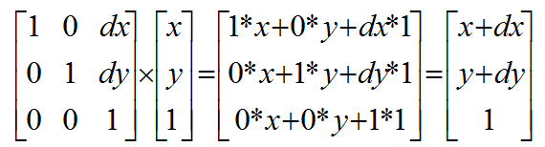

Translation

Slide 11
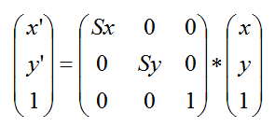

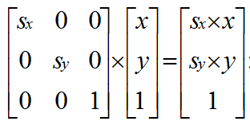

Scaling

Slide 12

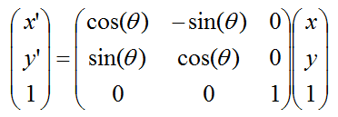
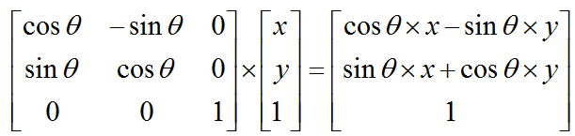
Rotation

Slide 13
At a glance…
Translation:
Scaling
Rotation

Slide 14
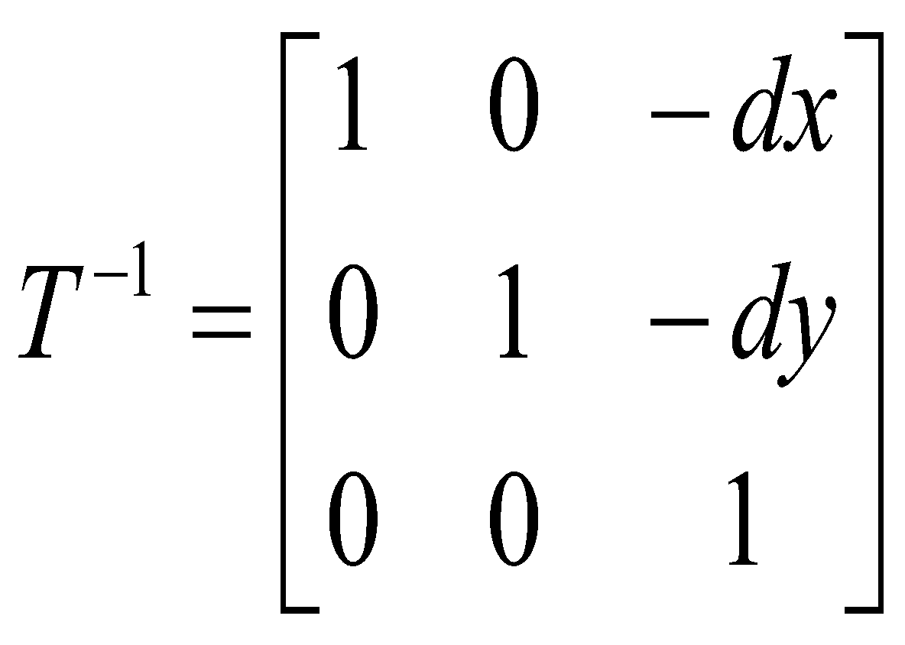
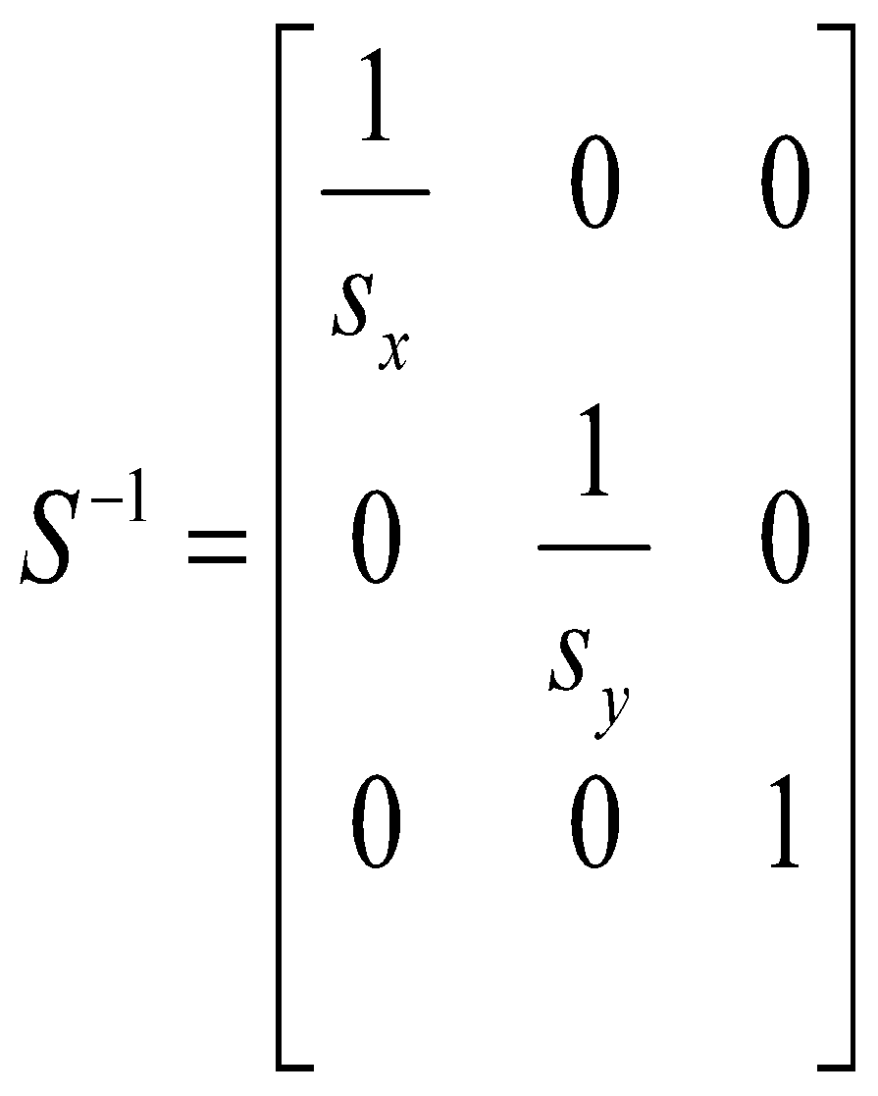
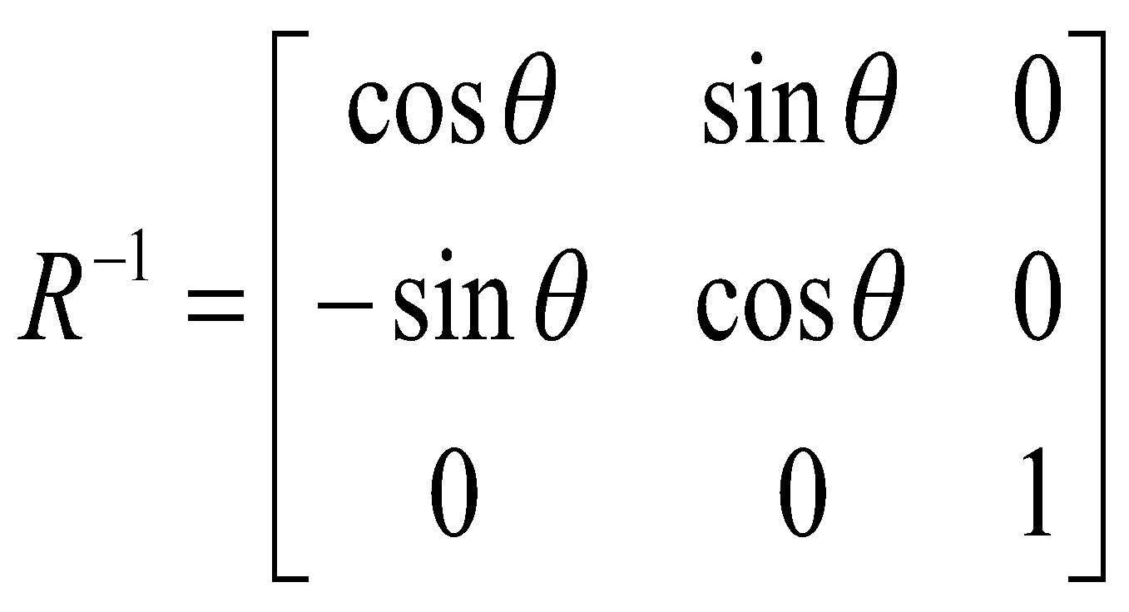
Inverse Transformations
Transformations can easily be reversed using inverse transformations

Slide 15
Combining Transformations
A number of transformations can be combined into one matrix to make things easy
Allowed by the fact that we use homogenous coordinates
Imagine rotating a polygon around a point other than the origin
Transform to centre point to origin
Rotate around origin
Transform back to centre point
Notes:
‹#›

Slide 16
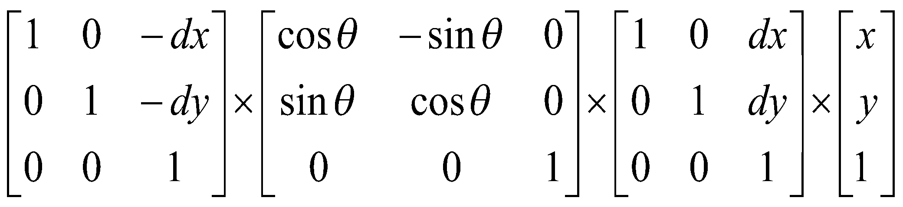
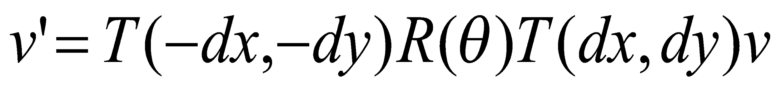
Combining Transformations (cont…)
The three transformation matrices are combined as follows
REMEMBER: Matrix multiplication is not commutative so order matters
Notes:
‹#›

Slide 17
Summary
2D Transformations
Translation
Scaling
Rotation
Homogeneous coordinates
Matrix multiplications
Combining transformations
Notes:
‹#›

Slide 18
Thank You

